Slide 1
Deep Learning in Quantum Machine Learning
Rob Grau

Slide 2
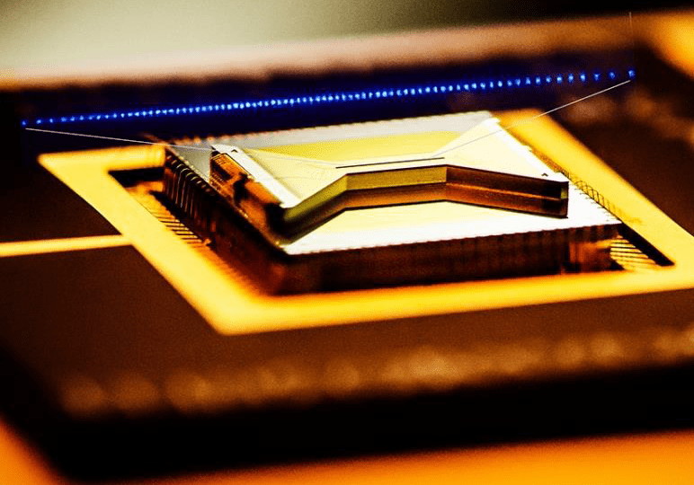
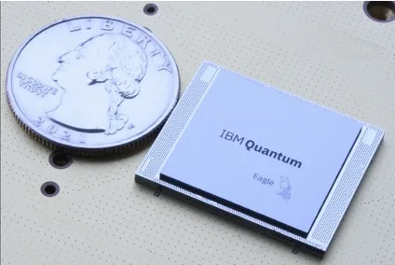
Quantum Chips
Sources: IonQ, IBM

Slide 3
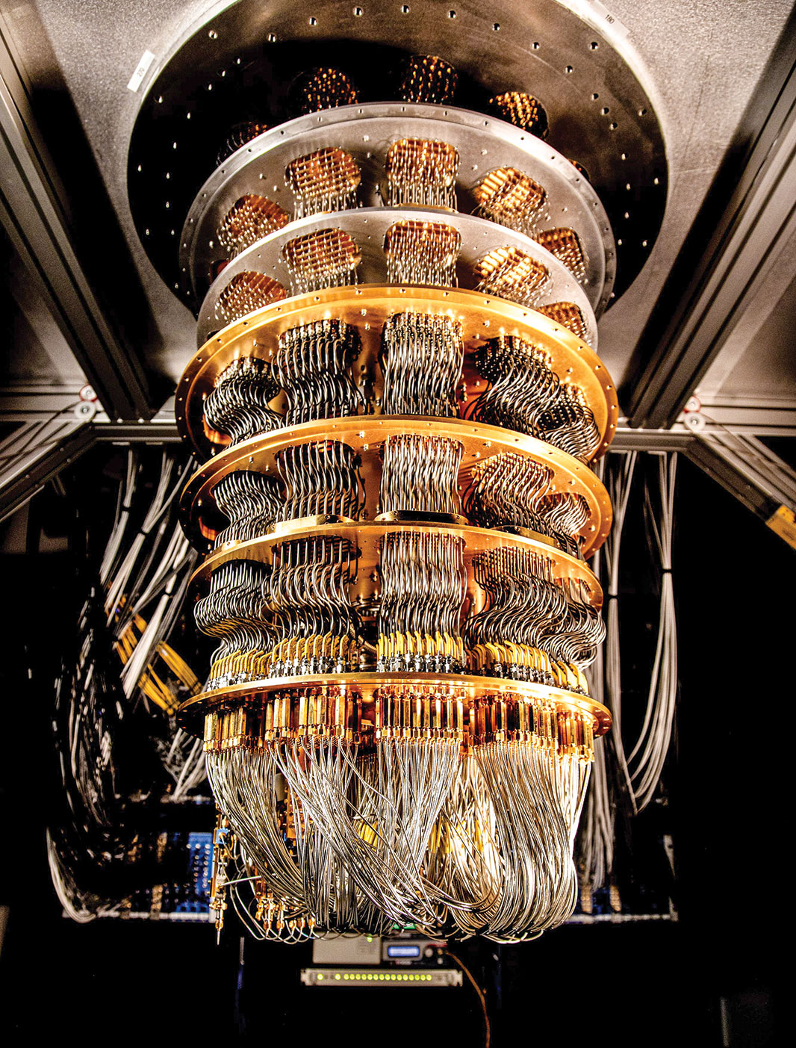
Quantum Hardware
Source: Google

Slide 4
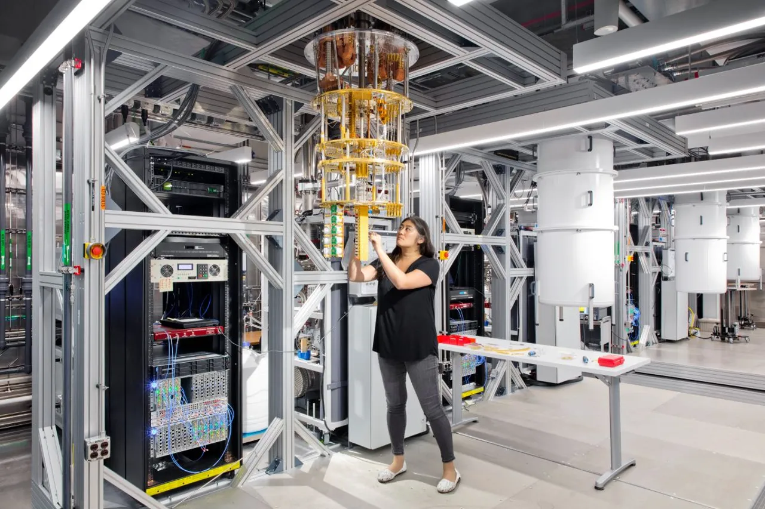
Quantum Hardware
Source: IBM

Slide 5
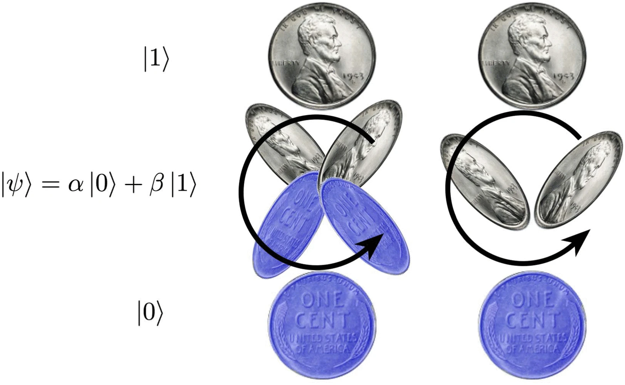
Quantum Bits
(qubits)
Source: E. W. Bethel et al., "Quantum Computing and Visualization: A Disruptive Technological Change Ahead" in IEEE Computer Graphics and Applications, vol. 43, no. 06, pp. 101-111, Nov.-Dec. 2023, doi: 10.1109/MCG.2023.3316932.

Slide 6
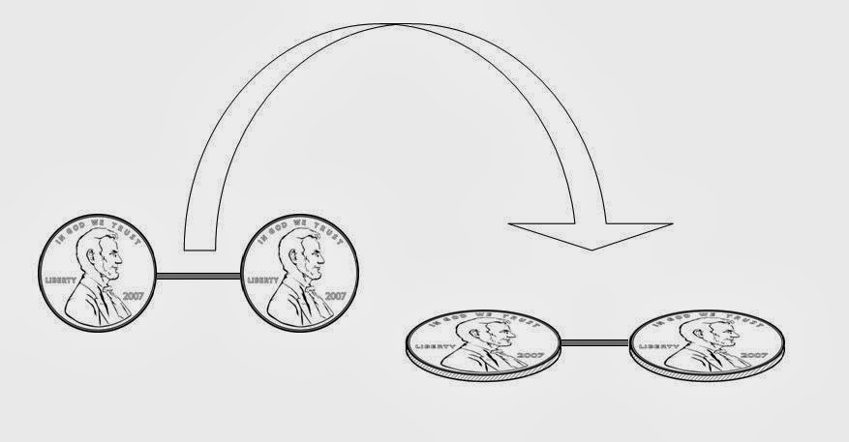
Quantum Entanglement
Source: https://quantumgazette.blogspot.com/2014/02/understanding-quantum-entanglement.html

Slide 7
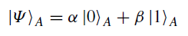
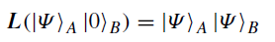
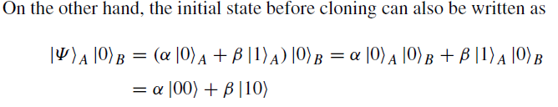
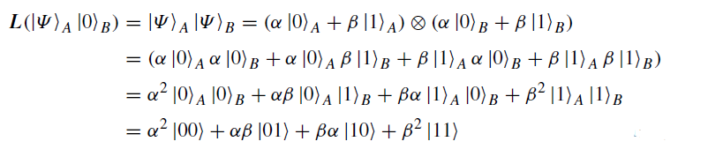
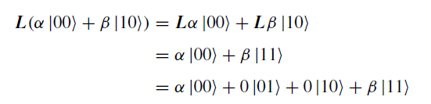
No-Cloning Theorem
Proof by contradiction
Let the cloning operator be L, which is an operator in the C4 space. We have
LHS Not equal to RHS
Therefore, it is possible to clone the basis states but NOT other superposition states.

Slide 8
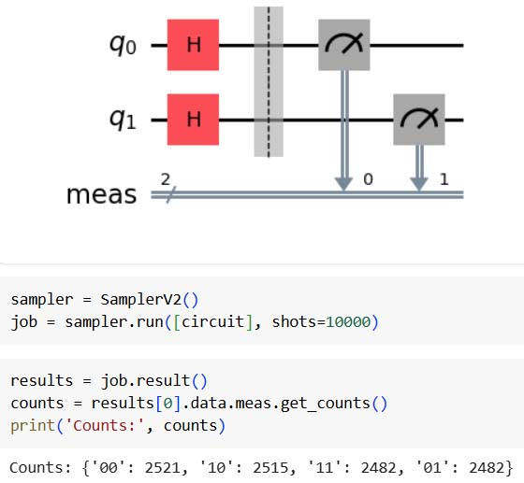
Quantum Circuit
Example
Hadamard (H) gate creates equal superposition of two basis states.
Source: IBM Qiskit Library for Python

Slide 9
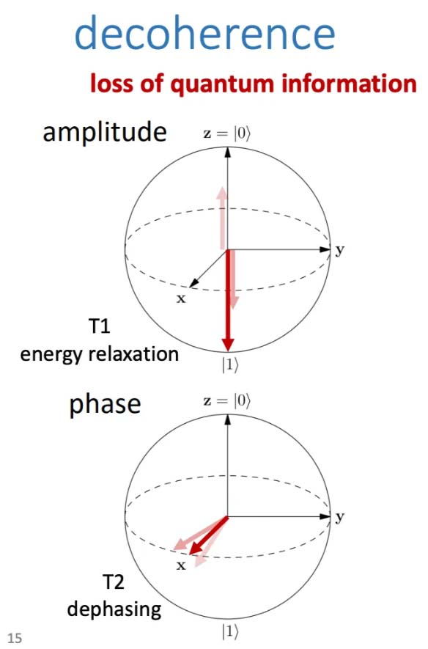
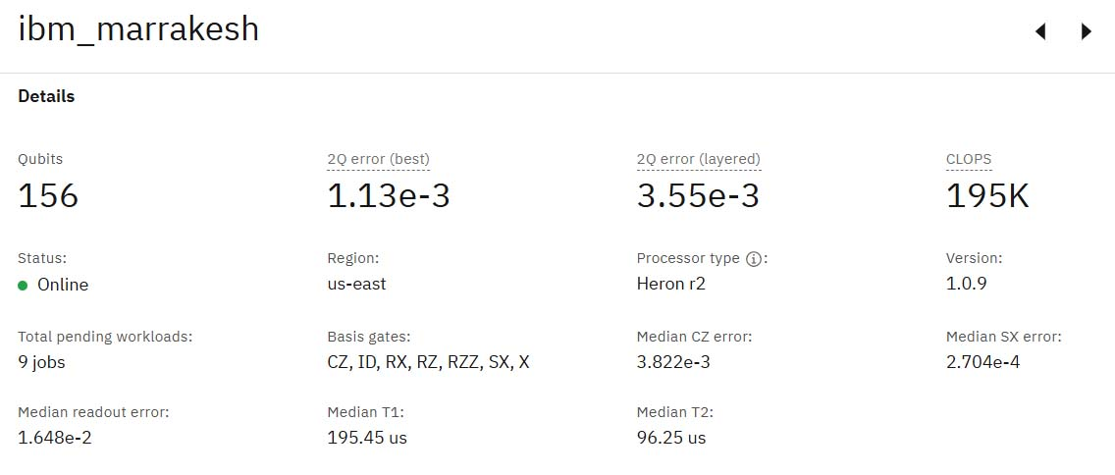
Quantum Decoherence
Source: https://quantum.ibm.com/services/
resources?system=ibm_marrakesh
Source: https://jonathan-hui.medium.com/
qc-quantum-programming-implementation-issues-51e3a146645e

Slide 10
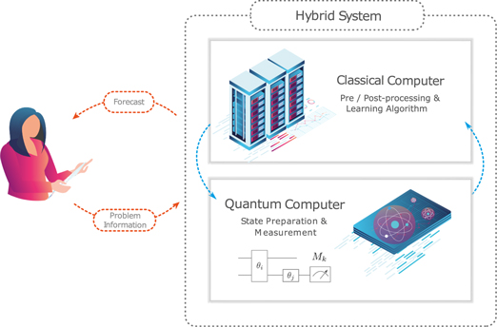
Hybrid
Quantum
ML
Source: Marcello Benedetti et al, Parameterized quantum circuits as machine learning models, Quantum Science and Technology (2019)

Slide 11
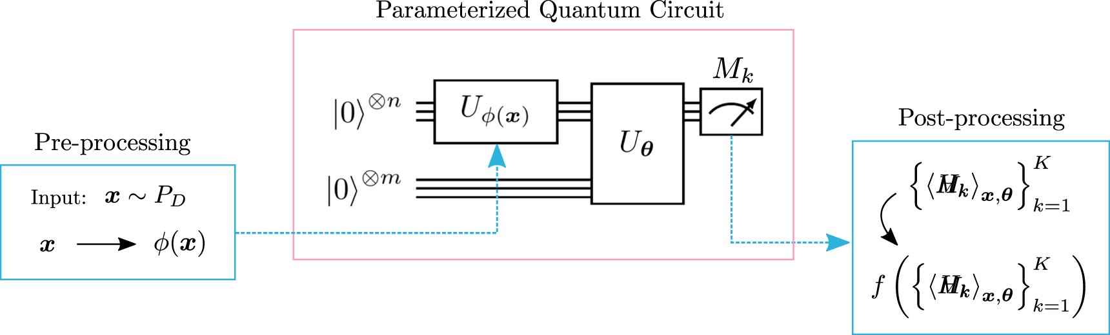
Parameterized Quantum Circuit
Source: Marcello Benedetti et al, Parameterized quantum circuits as machine learning models, Quantum Science and Technology (2019)

Slide 12
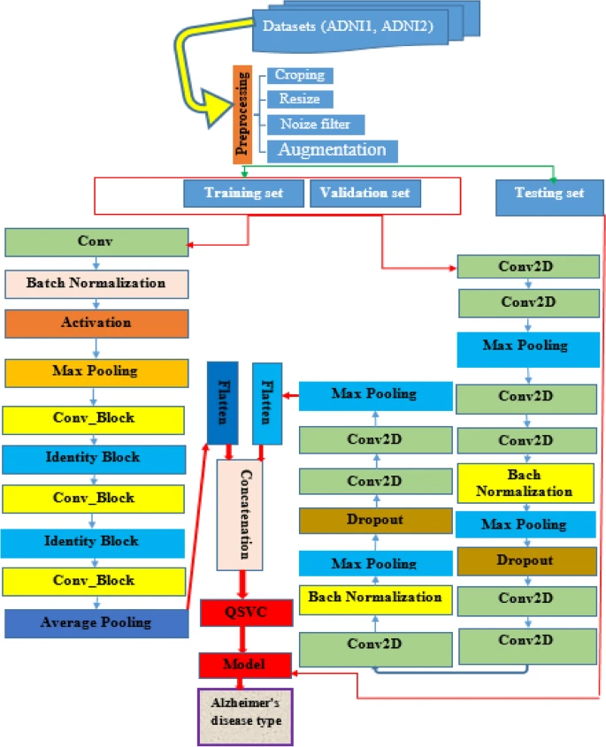
Ensemble QSVM Model
ADNI dataset from Kaggle
VGG16 and ResNet50 used for training.
Model outputs flattened and concatenated
Final layer is Quantum SVM
Source:Jenber Belay, et al. Deep Ensemble learning and quantum machine learning approach for Alzheimer’s disease detection. Sci Rep 14, 14196 (2024).

Slide 13
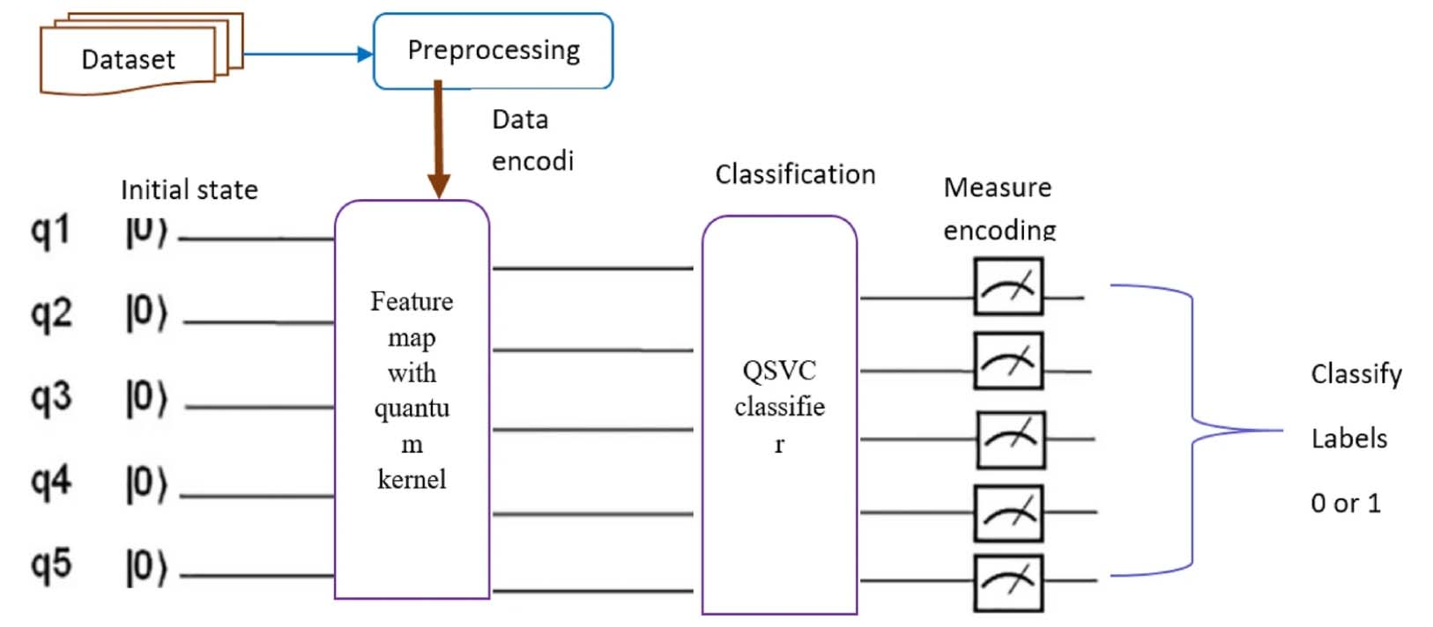
Ensemble QSVM Model – Classifying Test Data
Source:Jenber Belay, et al. Deep Ensemble learning and quantum machine learning approach for Alzheimer’s disease detection. Sci Rep 14, 14196 (2024).

Slide 14
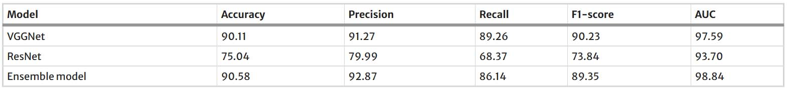
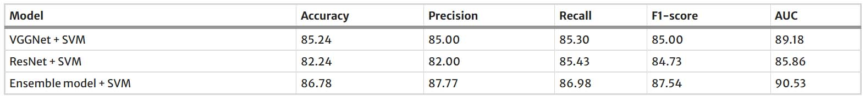
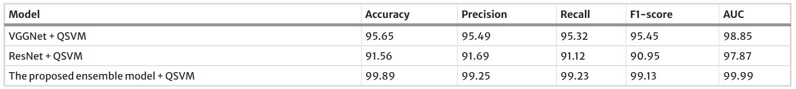
Ensemble QSVM Model – Results
Source:Jenber Belay, et al. Deep Ensemble learning and quantum machine learning approach for Alzheimer’s disease detection. Sci Rep 14, 14196 (2024).

Slide 15
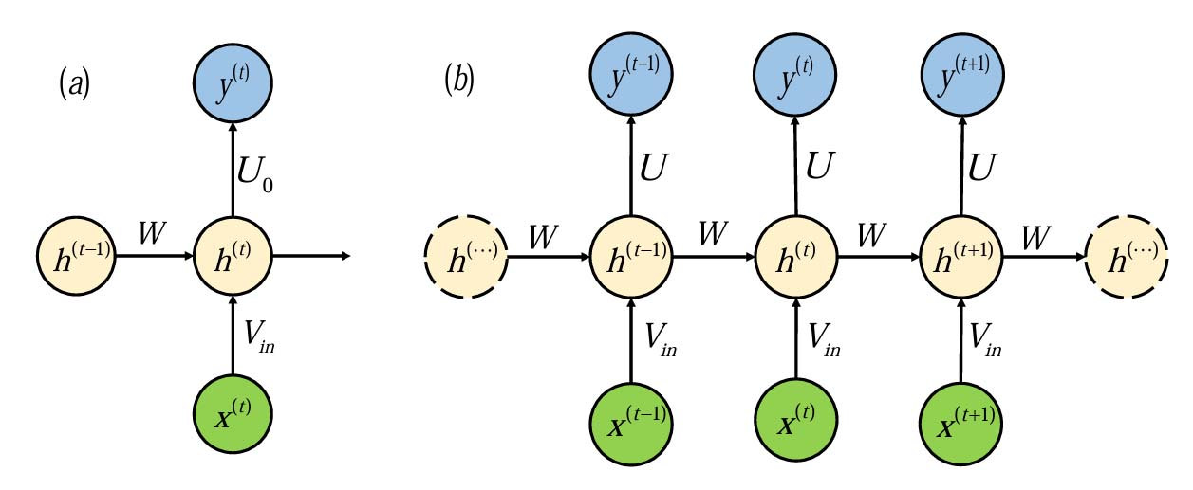
Quantum RNN Model
Modern Quantum Hardware limited by noise / coherence
Attempt to adapt recurrent LSTM cell to a function quantum algorithm
Source:Yanan Li, et al. Quantum recurrent neural networks for sequential learning, Neural Networks, Volume 166, Pages 148-161, (2023)

Slide 16
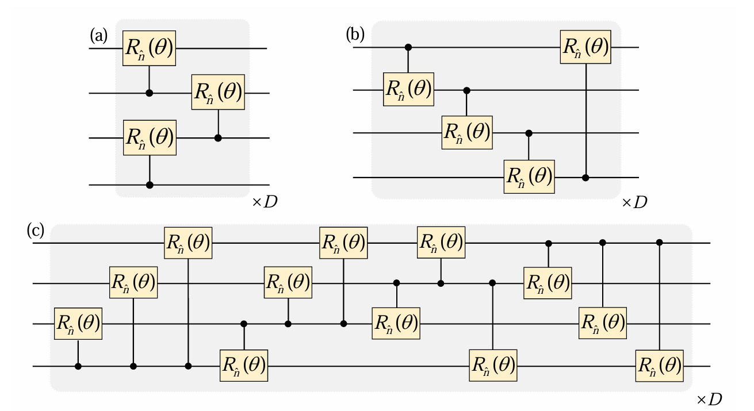
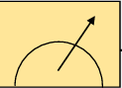
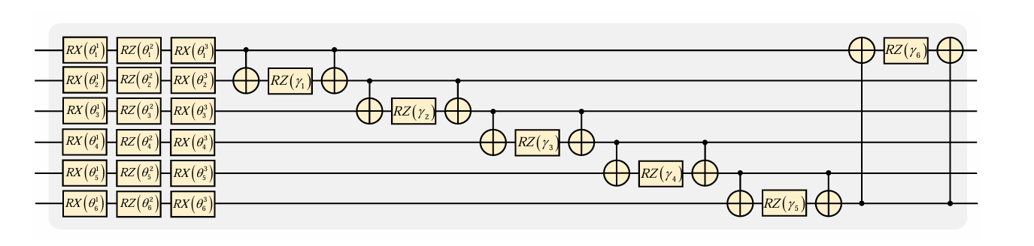
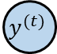
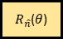
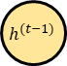
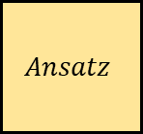
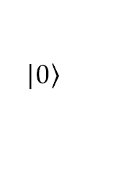
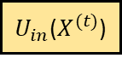
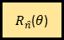
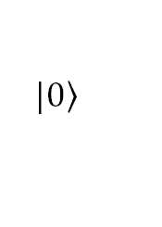
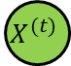
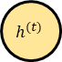
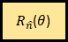
$$X^{(t)}$$
$$y^{(t)}$$
$R_{\hat{n}}$($θ$)
$$Ansatz$$
$R_{\hat{n}}$($θ$)
$R_{\hat{n}}$($θ$)
Reg. D
$$\left.|0\right\rangle$$
$U_{in}$($X^{(t)}$)
$$\left.|0\right\rangle$$
$R_{\hat{n}}$($θ$)
$R_{\hat{n}}$($θ$)
Reg. H
$$h^{(t−1)}$$
$$h^{(t)}$$
$R_{\hat{n}}$($θ$)
$R_{\hat{n}}$($θ$)
$R_{\hat{n}}$($θ$)
Structure of the quantum recurrent block inspired by basic classical recurrent block shown in Fig. 01
$R_{\hat{n}}$($θ$)
$R_{\hat{n}}$($θ$)
$R_{\hat{n}}$($θ$)
$R_{\hat{n}}$($θ$)
$R_{\hat{n}}$($θ$)
$R_{\hat{n}}$($θ$)
$R_{\hat{n}}$($θ$)
$R_{\hat{n}}$($θ$)
$R_{\hat{n}}$($θ$)
$R_{\hat{n}}$($θ$)
$R_{\hat{n}}$($θ$)
$R_{\hat{n}}$($θ$)
The circuits for the three configurations of two-qubit gates, (a) nearest-neighbor (NN), (b) circuit-block (CB), and (c) all-to-all (AA).
The circuit of the ansatz used in the figure above
Source:Yanan Li, et al. Quantum recurrent neural networks for sequential learning, Neural Networks, Volume 166, Pages 148-161, (2023)
Notes:
With the demonstrations of quantum supremacy, we are entering the NISQ era of quantum computing, where NISQ refers to the noisy intermediate scale quantum devices [9]. There is a growing consensus that NISQ devices may and useful applications in the near term. One of the most promising directions is the quantum neural network (QNN) [10, 11, 12]. QNN takes the parameterized quantum circuit (PQC) [13] as a learning model, which is a quantum analogue of the classical neural network.
https://arxiv.org/pdf/2302.03244

Slide 17
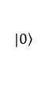
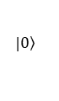
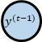
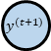
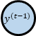
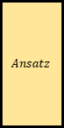
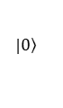
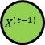
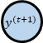
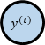
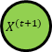
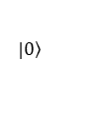
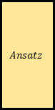
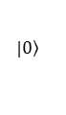
















Staggered Quantum Recurrent Neural Network
An sQRNN is a type of Quantum Recurrent Neural Network (QRNN) where Quantum Recurrent Blocks (QRBs) are arranged in a staggered fashion, allowing qubits to be reused across time steps. This staggered structure reduces the demand for long coherence times, a major constraint in NISQ devices.
$$X^{(t−1)}$$
$$y^{(t−1)}$$
$$X^{(t)}$$
$$y^{(t)}$$
$$X^{(t+1)}$$
$$y^{(t+1)}$$
$$X^{(t−1)}$$
$$y^{(t−1)}$$
$$X^{(t)}$$
$$y^{(t)}$$
$$X^{(t+1)}$$
$$y^{(t+1)}$$
Reg. D
$$\left.|0\right\rangle$$
$$\left.|0\right\rangle$$
$$\left.|0\right\rangle$$
$$Ansatz$$
$$\left.|0\right\rangle$$
$U_{in}$($X^{(t−1)}$)
$$Ansatz$$
$U_{in}$($X^{(t)}$)
$$Ansatz$$
$U_{in}$($X^{(t+1)}$)
$$Ansatz$$
$$\left.|0\right\rangle$$
$U_{in}$($X^{(t−1)}$)
$$Ansatz$$
$$\left.|0\right\rangle$$
$$Ansatz$$
$$\left.|0\right\rangle$$
$$\left.|0\right\rangle$$
$$\left.|0\right\rangle$$
$$\left.|0\right\rangle$$
$U_{in}$($X^{(t)}$)
$$\left.|0\right\rangle$$
$$\left.|0\right\rangle$$
$$\left.|0\right\rangle$$
$$\left.|0\right\rangle$$
$$\left.|0\right\rangle$$
$$\left.|0\right\rangle$$
$$\left.|0\right\rangle$$
$U_{in}$($X^{(t+1)}$)
Reg. H
$$\left.|0\right\rangle$$
The straightforward way of building the QRNNs using the QRB
The second architecture of QRNN, which is built by arranging the QRB in a staggered way. This model is called as sQRNN
Source:Yanan Li, et al. Quantum recurrent neural networks for sequential learning, Neural Networks, Volume 166, Pages 148-161, (2023)

Slide 18

Quantum RNN Model - Results
Ran model on classic sequential datasets, meteorological data, stock price data, and text language processing. Meteorological results below.
Source:Yanan Li, et al. Quantum recurrent neural networks for sequential learning, Neural Networks, Volume 166, Pages 148-161, (2023)

Slide 19
What’s parallel about quantum?
Primarily, quantum speedup achieved through superposition
NVIDIA CUDA-Q available to accelerate hybrid models on GPUs
Availability of quantum processors remains a bottleneck

Slide 20
What’s the future of quantum?
Development of better quantum processors.
Need meaningful quantum error correction to scale.
With improvements, can turn theory into practice.

Slide 21

Questions?
Source: Microsoft

